Slide 1

SAFE ZONE
The Safe Zone App Designed For Smart Parking Solutions

Slide 2
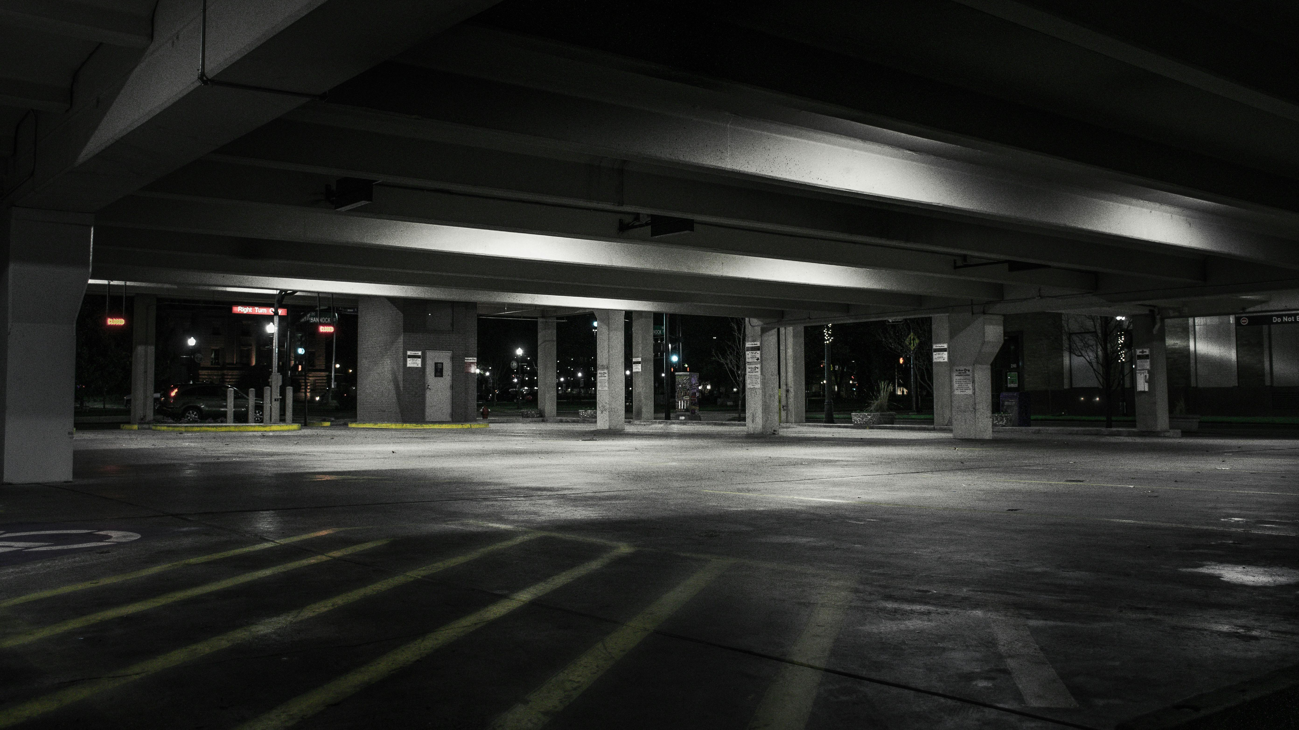
OUR AGENDA
INTRODUCTION
MISSION & VISION
PROBLEMS & SOLUTIONS
KEY FEATURES
FUTURE FEATURES
SYSTEM ANALYSIS

Slide 3
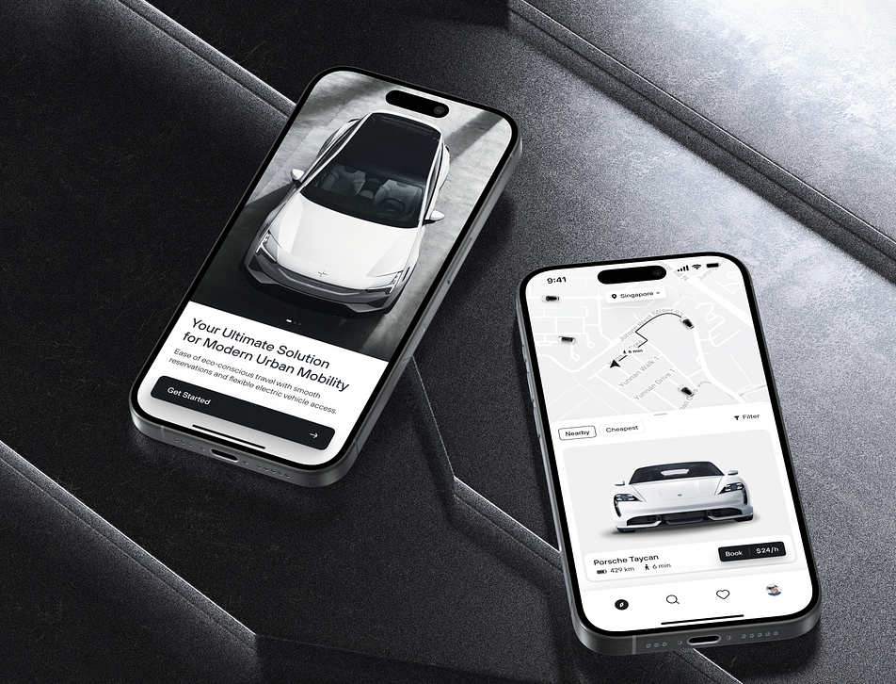
Safe Zone App Services
The Safe Zone app is designed for car owners who are traveling, and they can not take care of their cars.
Is designed to provide users with a secure and convenient solution for parking their vehicles.
They can view live video streams of their parked cars, ensuring peace of mind and add security against theft or damage.
Allowing users to keep an eye on their vehicles from anywhere and any time.
It allows users to find and reserve parking spaces in designated Safe Zone parking lots.

Slide 4
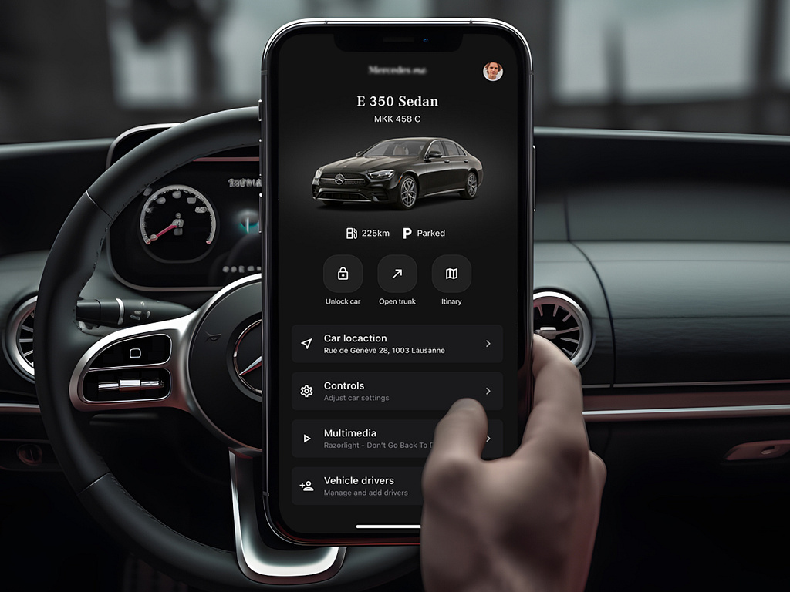
CUSTOMER PROBLEMS
Lack of Secure Parking
Time-Consuming Search for Parking
Remote Monitoring
Theft and Damage
Convenience

Slide 5
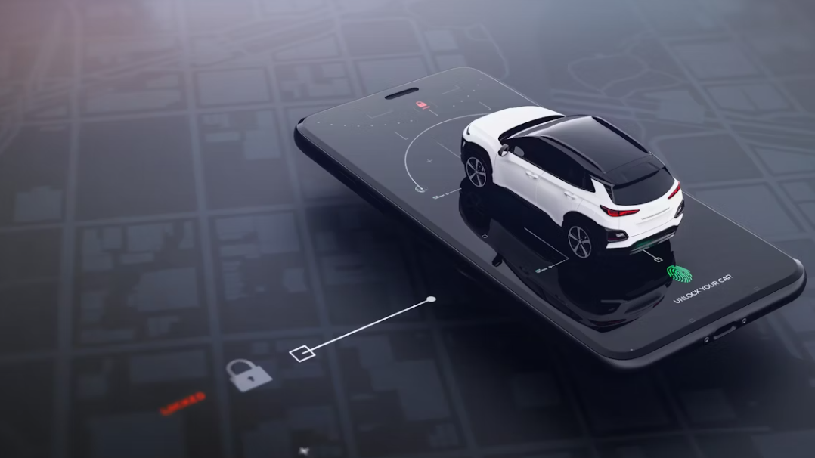
OUR VISION
We seek for providing luxury services for vehicles of the A A class and to expand & Stand still in the market, to raise our market share & to raise revenue .
OUR MISSION
to provide the user with secured & safe parking lots , sending him regular updates on his vehicle in an attempt to reach the customer satisfaction.

Slide 6
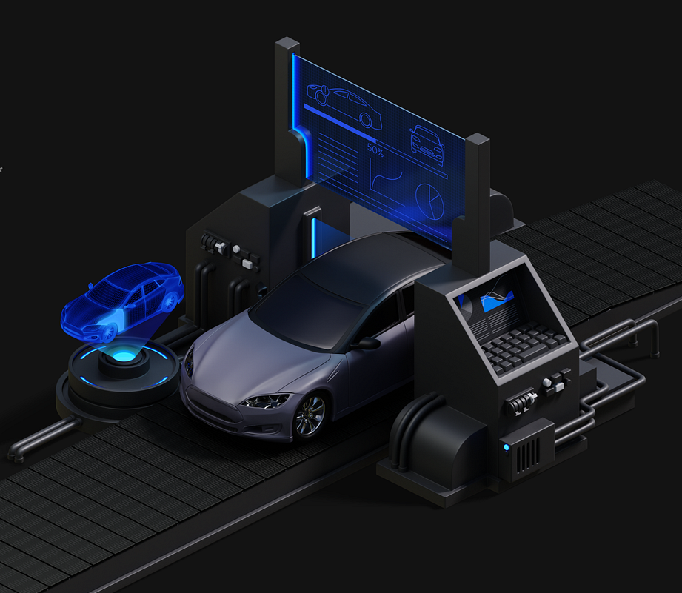
Differentiation
With the spread of smartphones , this made the users more comfortable with mobile apps in their service reception. So , This trend provides us to build a strong foundation for the adoption of a car services app.
Market Demand
The increasing reliance on vehicles for daily transportation has created a great demand for efficient and reliable car services.

Slide 7
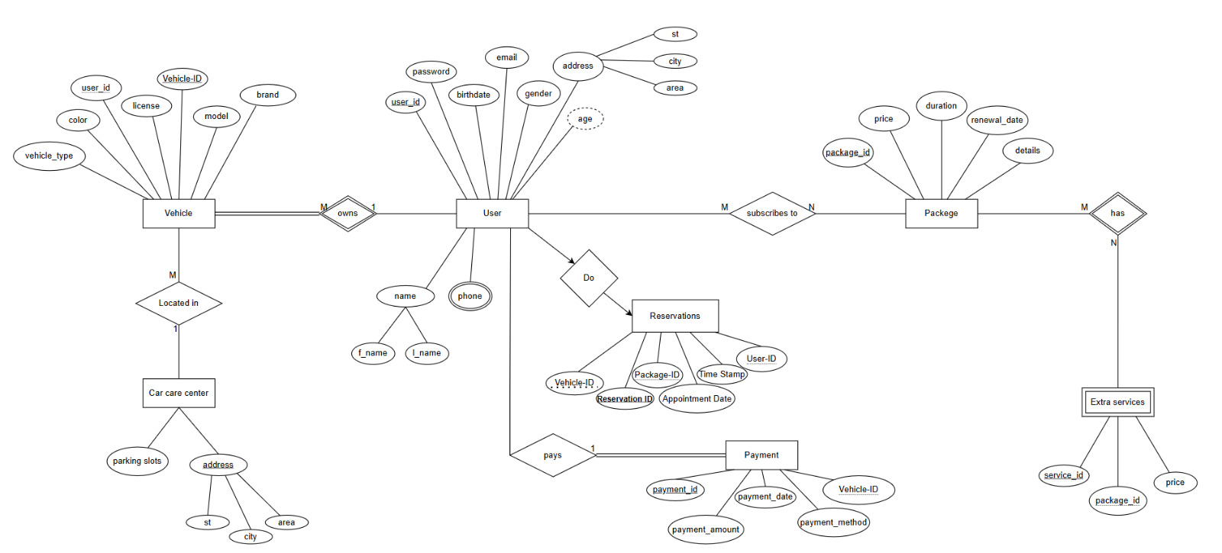
Entity Relationship Diagram

Slide 8
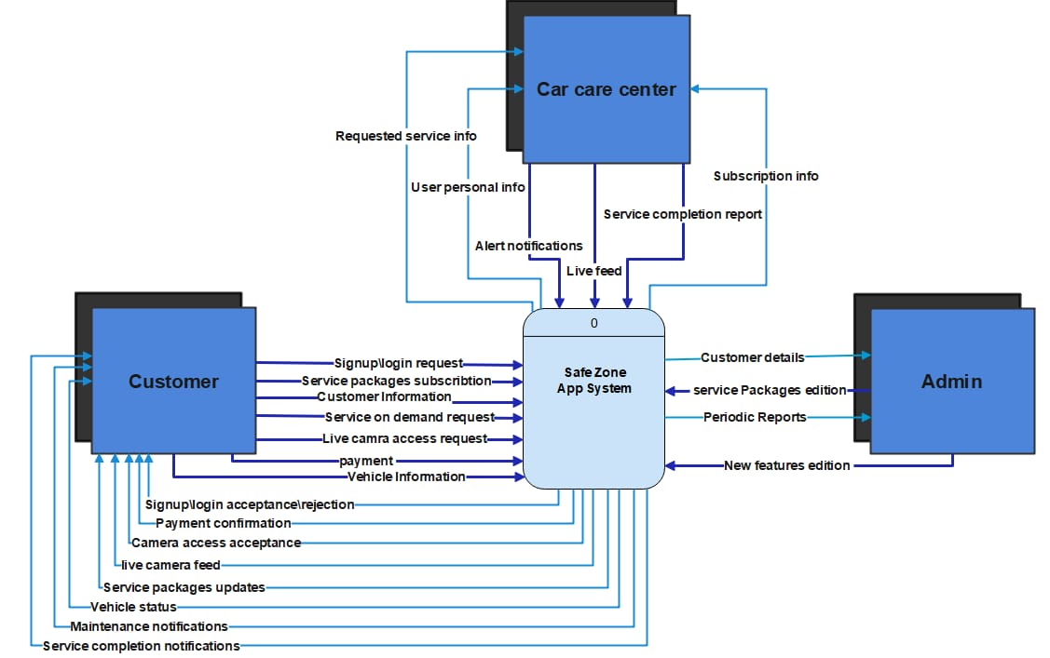
CONTEXT DIAGRAM

Slide 9
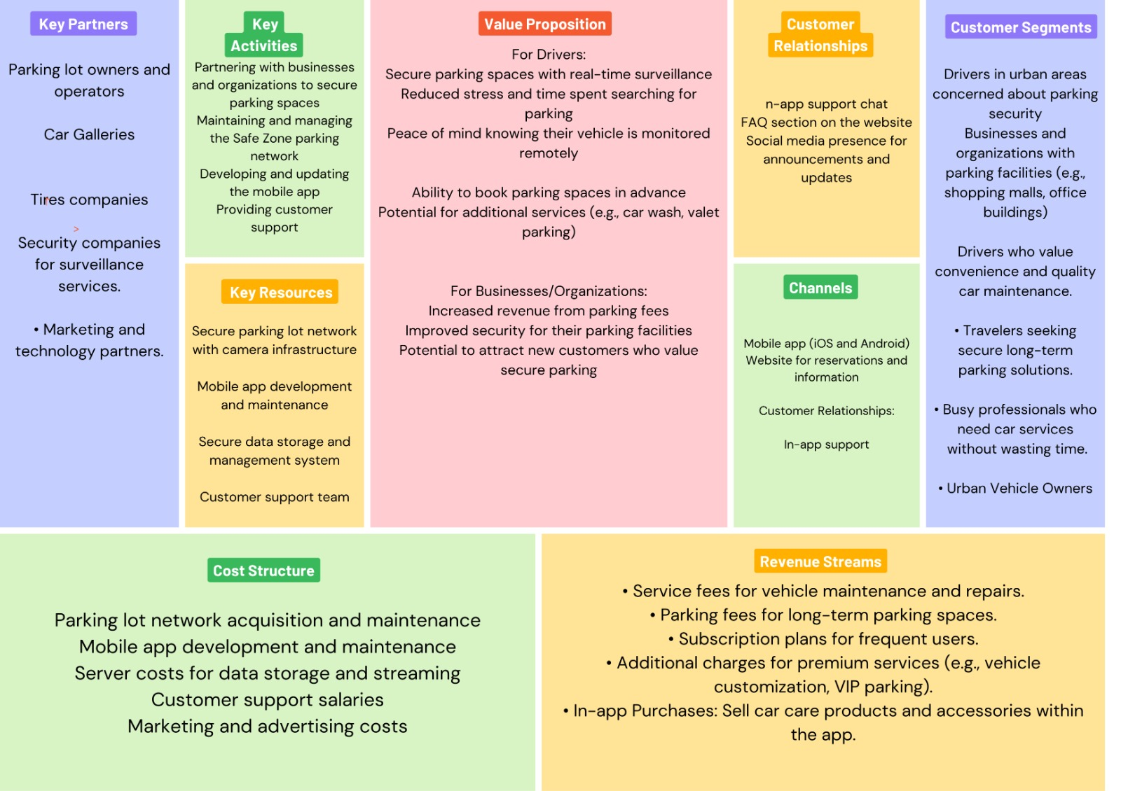
BUSINESS MODEL

Slide 10
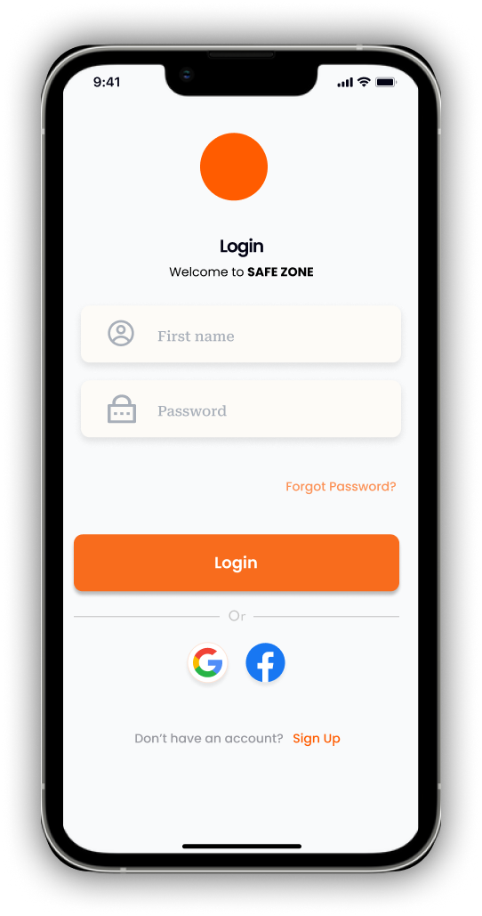
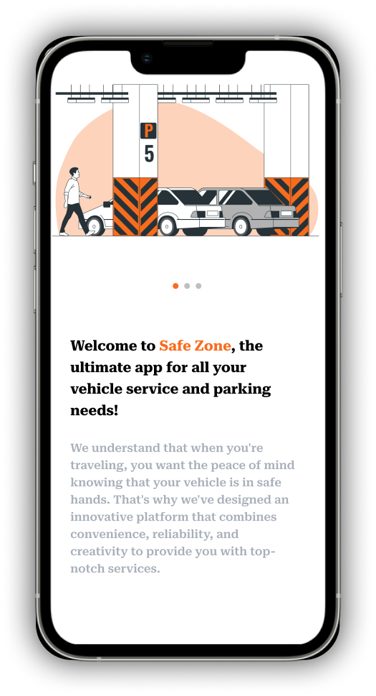
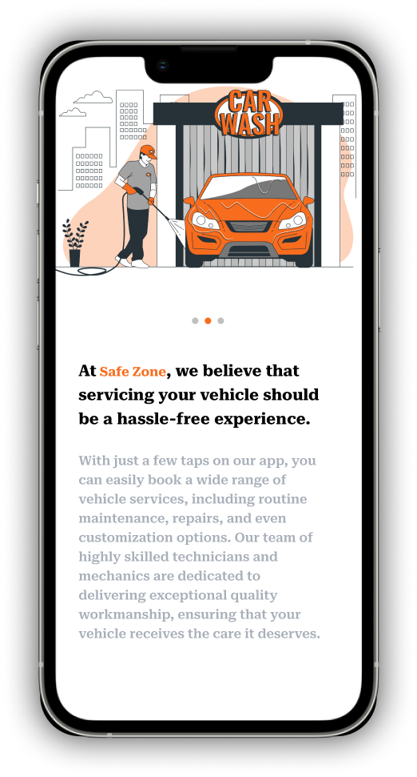
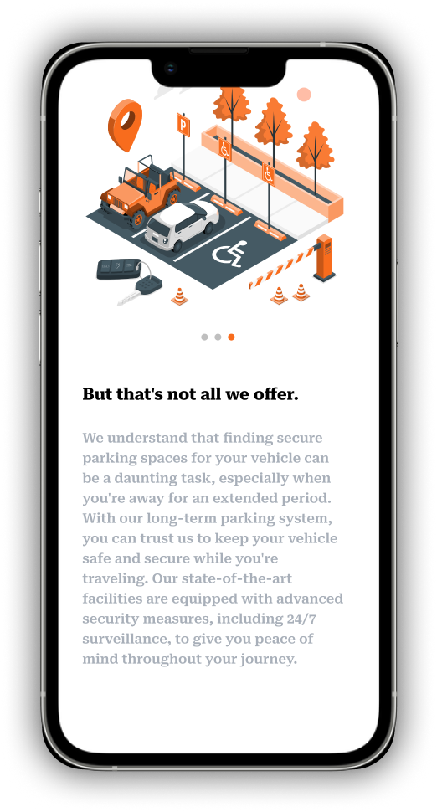
KEY FEATURES FOR SMART ZONE APP
The app provides a comprehensive range of features including real-time service booking and personalized user profiles. These features collectively enhance the overall user experiments and convenience.

Slide 11
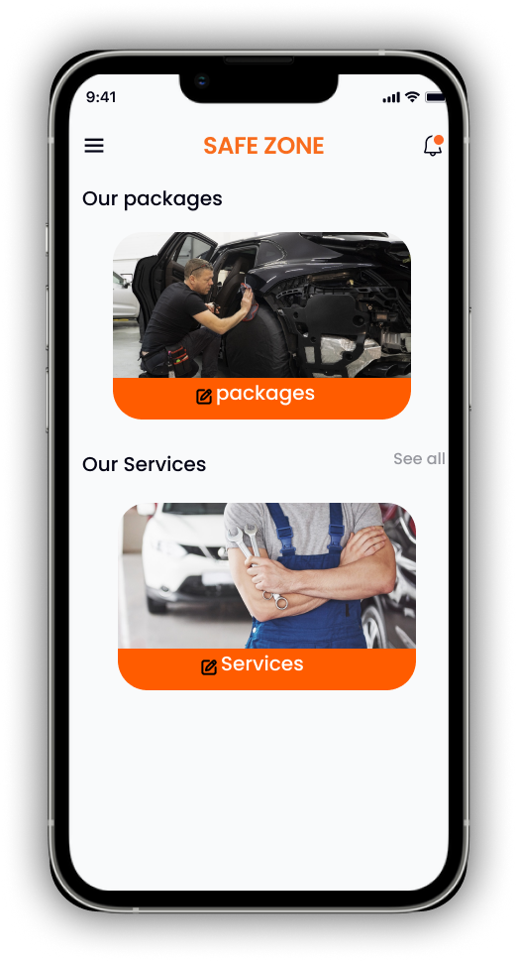
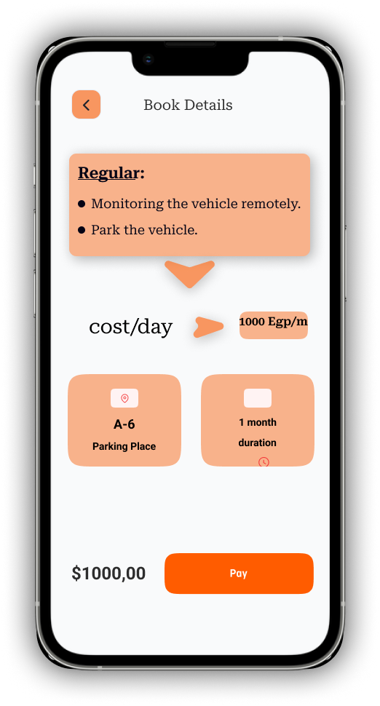
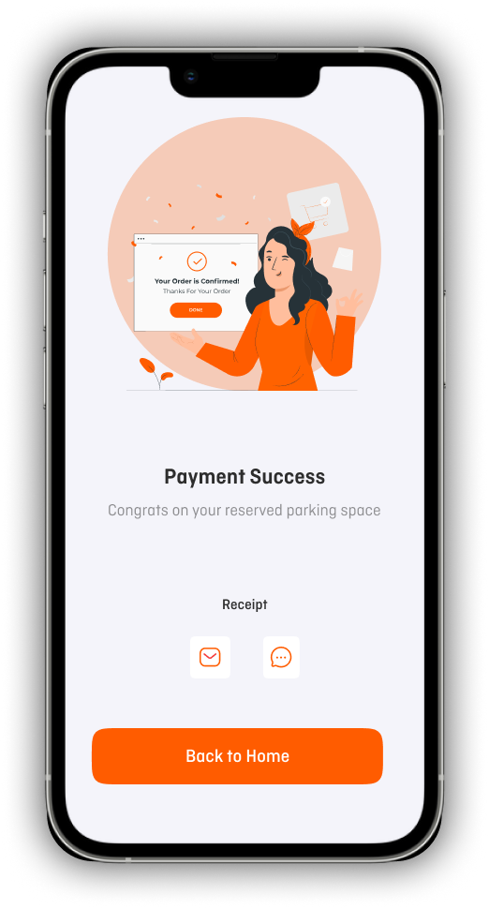
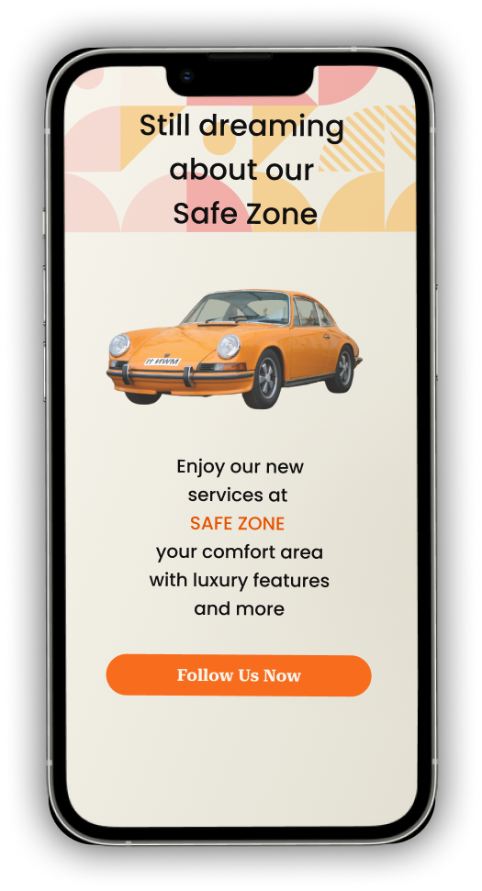
KEY FEATURES FOR SMART ZONE APP

Slide 12
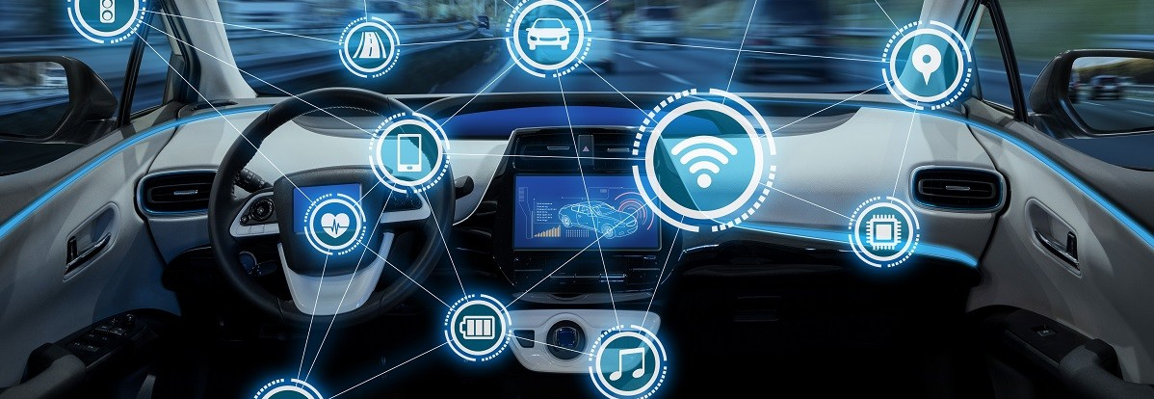
FUTURE FEATURES FOR SMART ZONE APP
Emergency Assistance:
Request roadside help for flat tires, dead batteries, or lockouts.
Loyalty Program:
Earn points for bookings, redeemable for discounts or free services and online payments.
Eco-Friendly Options:
Access oil recycling, eco-friendly car washes.

Slide 13

MADE BY
Yumna Muhammed Saad
Abdelrahman Nabil
Abdelrahman Othman
Abdelrahman Sherif
Mohammed Fouad
Mohammed Abdel Aziz
Mohammed Mohammed
Youssef Serif
Reem Essam El-Deen
Salma Gamal
Rana Saied
Nayera Abdelshafi
THANK YOU

